Slide 1

St. Louis Day of Dot Net 2011
Jump Start: SharePoint Development
Becky Bertram
Independent SharePoint Consultant
SharePoint MVP, MCSD.NET, MCTS
www.beckybertram.com
@beckybertram

Slide 2
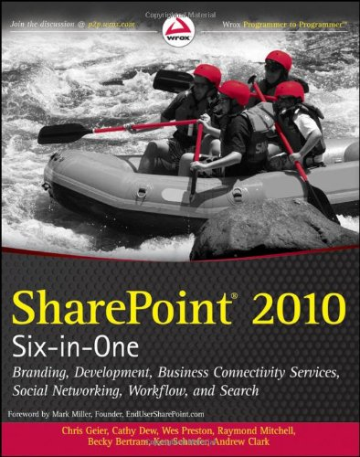
SharePoint Six-in-One
The information in this presentation is condensed from chapters 7 and 8, authored by myself, in “SharePoint 2010 Six-in-One”, published by Wrox.

Slide 3
Topics
What is a SharePoint feature?
What is a SharePoint solution?
What are my development tools?
Using Visual Studio 2010 with SharePoint
Ways of interacting with SharePoint:
  CAML
  Server Object Model
  Client Object Model
  LINQ to SharePoint
  REST
  SharePoint Web Services

Slide 4
Features and Solutions

Slide 5
What is a SharePoint Feature?
A unit of functionality within SharePoint that can be turned on, or “activated”.
Hard to describe because it can be essentially any piece of functionality in SharePoint.
You could write a feature to:
  Add a site column, content type, or list to a site.
  Add an item to a list
  Start a timer job.
  Kick off a workflow
  Add a web part to a page
  Etc.

Slide 6
Scope
4 different scopes: Farm, Web Application, Site Collection, Site
A feature can be activated only once per item at the given scope. (For instance, a feature scoped to the Site Collection level could be activated in both the “HR” and “IT” site collections, but it could only be activated once in the HR site collection and activated only once in the IT site collection.)
Examples: Feature that deploys a master page would be scoped to Site Collection level, while feature that adds a particular document library to a site could be scoped to the Site level.

Slide 7
Reusability
Because features can be reused, you ensure that the exact same behavior will happen in the exact same way across farms, web applications, site collections, or sites, (as opposed to using a tool like SharePoint Designer, or making the change in the browser, where human error could accidentally make a mistake).

Slide 8
Activation Dependency
Features can be dependent on one another, which means one feature cannot be activated until another feature has been activated first.
Example: I have one feature scoped to the Site Collection level called “My List Def” that deploys a custom list definition to the site collection called My Custom List. I have another feature scoped to the Site level, called “My List”, which, when activated, creates an instance of My Custom List in the local site. The “My List” feature is dependent on the “My List Def” feature.

Slide 9
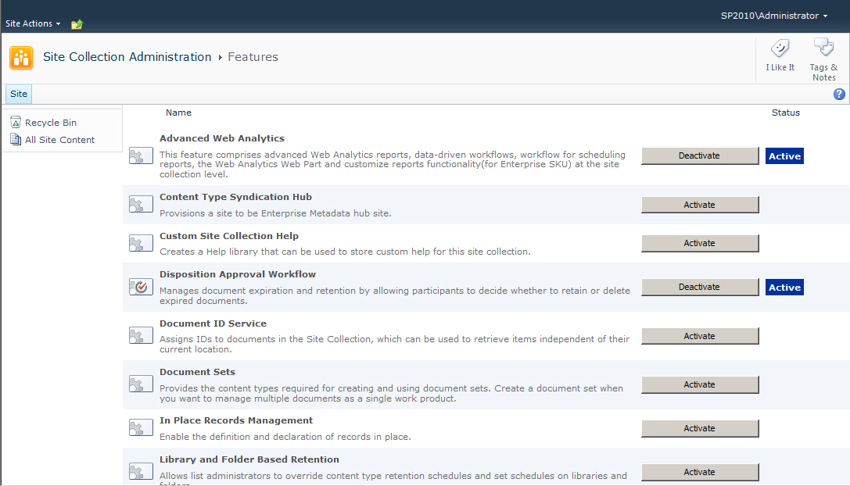
Feature Activation/Deactivation
Features can be activated or deactivated via the browser or by using PowerShell

Slide 10
Feature Folder
Each feature contains a folder that includes files related to that feature:
  Element files (ASPX pages, images, etc.)
  Element manifest files (tell SharePoint what to do with element files, such as add an item to a list)
  Feature manifest (Feature.xml – tells SharePoint which element manifest files to execute, as well as properties of the feature, such as its name and scope)

Slide 11
What is a Solution?
A solution package is just a cabinet file with an extension of WSP.
A solution is a mechanism for deploying assets to your SharePoint server farm.
  Assets: assembly, files, features
  Manifest: solution properties, assembly location, feature location, web.config changes
Solutions work across a load balanced farm.

Slide 12
Solutions and Features
Solutions can contain references to features.
Example: I have a feature called “My Web Part” that includes a compiled web part. When activated, the feature adds that web part to the Web Part Gallery of the site collection.
The solution package would contain:
a reference to the feature manifest file
the assembly used by the web part
an instruction that the web.config must be updated to tell SharePoint that it’s okay to use that web part’s assembly (i.e. mark the web part type as “safe”).

Slide 13
Sandboxed vs. Farm Solutions
Farm solutions deploy assets to the server file system and assemblies are executed from within the web server process.
Sandboxed solutions are extracted and run within their own separate “sandboxed” process, and are thus safer.
Sandboxed solutions have reduced functionality, but are safer to use when the site is co-located. Sandboxed solutions can be deployed by site administrators, whereas farm solutions must be deployed by server admins.
Resource throttling prevents “rogue” sandboxed solutions from chewing up server resources.
Farm solutions added to server via PowerShell (or STSADM tool), deployed via PowerShell or Central Admin. Sandboxed solutions uploaded to Solutions Gallery, deployed from there.

Slide 14
Customization vs. Development
Customization involves making changes to a particular site collection or site, usually by means of a tool like SharePoint Designer, or via the web browser.
Development involves the creation of solution packages, features, etc., which can be used repeatedly in different environments. Developers utilize a tool like Visual Studio.

Slide 15
Visual Studio 2010
Visual Studio 2010 must be used to build SharePoint 2010 applications. You can use Visual Studio 2010 to build SharePoint 2007 solution packages, but you still have to do the manual work to compile the packages.
Visual Studio 2010 comes with a number of built in project templates that can serve as a starting point for building SharePoint solutions.
Built-in debugging functionality

Slide 16
VS Third Party Add-Ons
SharePoint Power Tools: http://visualstudiogallery.msdn.microsoft.com/8e602a8c-6714-4549-9e95-f3700344b0d9/
CKS-Dev:
http://cksdev.codeplex.com/

Slide 17
Demo: Creating a Solution Package

Slide 18
Developing for SharePoint

Slide 19
CAML
Collaborative Application Markup Language
Gives instructions telling SharePoint how to add assets to the content database.
  Adding an item to a list (including adding items to libraries)
  Adding a list or library to a site
  Adding a content type or site column to a site
Can also be used to retrieve items from the content database much like a SQL query, using “where”, “sort by” and “group by clauses”. This is called a CAML Query.

Slide 20
CAML Example
<Field Type="Choice"
Group="My Custom Columns"
DisplayName="Fiscal Quarter"
Name="FiscalQuarter"
ID="{0DFD4BB2-DBC8-461b-8A2E-E7E5D077F679}">
<CHOICES>
<CHOICE>Q1</CHOICE>
<CHOICE>Q2</CHOICE>
<CHOICE>Q3</CHOICE>
<CHOICE>Q4</CHOICE>
</CHOICES>
</Field>

Slide 21
Server Side Object Model
Many of the core classes are contained in the Microsoft.SharePoint.dll assembly, and the Microsoft.SharePoint namespace.
Core classes often start with “SP”, such as:
  SPFarm
  SPWebApplication
  SPSite (site collection)
  SPWeb (site)
  SPList
  SPListItem

Slide 22
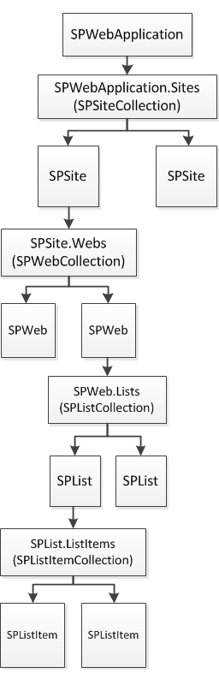
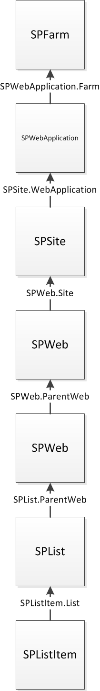
SSOM Hierarchy
The hierarchy of objects is fairly intuitive; each item contains a collection of lesser items, and each item can access its parent item.

Slide 23
Client-side Object Model
Used to access SharePoint from a location outside of the SharePoint environment
3 CSOM API’s:
  Client-side API for running code in a .NET 3.5 (or higher) managed code application
  Silverlight API
  ECMAScript API (i.e. javascript)
Executes commands in batches, so as to reduce round-trips to server

Slide 24
CSOM Example (Client-side API)
using System;
using Microsoft.SharePoint.Client;
…
ClientContext ctxt = new ClientContext("http://intranet/");
Web marketingSubsite = ctxt.Web;
ctxt.Load(marketingSubsite);
ctxt.ExecuteQuery();
string siteTitle = marketingSubsite.Title;
ListCollection lists = marketingSubsite.Lists;
ctxt.Load(lists);
ctxt.ExecuteQuery();
marketingSubsite.Title = "New Title";
marketingSubsite.Update();
ctxt.ExecuteQuery();
string newTitle = marketingSubsite.Title;
Console.WriteLine(lists.Count.ToString());
Console.WriteLine(newTitle);

Slide 25
LINQ to SharePoint
Provides a way of querying SharePoint in assemblies using SQL-like syntax and strongly-typed classes.
Must use the SPMetal.exe tool to generate entity classes.
Example: If you have a list called “Customers” with two columns: “First Name” and “Last Name”, the entity classes generated would allow you to access the list using an object called Customers, which would contain a collection of Customer objects. You could access the value stored in the First Name column by using the Customer.FirstName property, etc.

Slide 26
RESTful Interface
REpresentational State Transfer interface
Uses HTTP operations of POST, GET, PUT and DELETE to interact with SharePoint data.
Allows you to use URLs to retrieve data from SharePoint remotely, by appending “/_vti_bin/ListData.svc” to your site URL.
Examples:
  Retrieves the title of the second item in the Accounting site’s Documents list:
  http://intranet/sites/accounting/_vti_bin/ListData.svc/Documents(2)/Title
  Returns an XML-formatted list of documents from the document library where the title of the document is “My Document”:
  http://intranet/sites/accounting/_vti_bin/ListData.svc/Documents?filter=Title eq ‘My Document’

Slide 27
SharePoint Web Services
Fairly neglected in SP2010, since goal was to get people to use the CSOM instead of web services to access SharePoint.
Web services are found in the /_vti_bin directory of your web application. Like REST, append URL of web service to current site to get data from that site. For example, you can retrieve list data from the HR site by accessing http://intranet/sites/HR/_vti_bin/Lists.asmx.
You can use the Lists web service to pass in query information via XML, which will in turn return an XML-formatted list of list data.

Slide 28
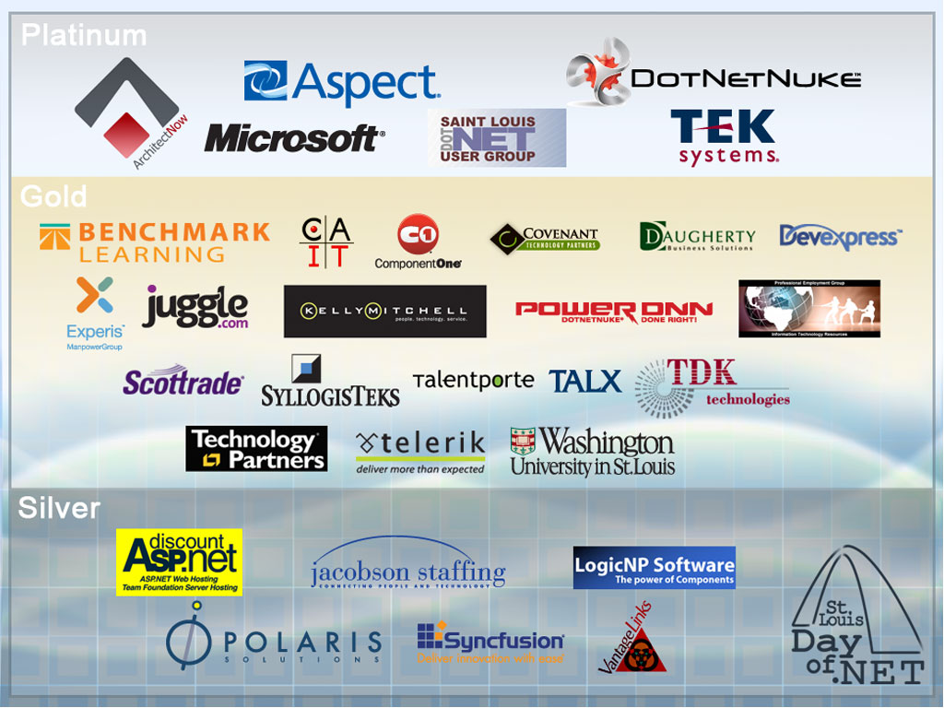

Slide 29
Questions?

